Slide 1
Stallion RFID Enabled Vehicle Tracking System

Slide 2
Project Scope
RFID enabled vehicle Management System is a small system that can solve a problem that really bothers many vendors today for managing incoming and outgoing vehicles by checking the validity of vehicles.
Automatic boom barriers with Signal lamps also can be incorporated in the system.

Slide 3
Why Stallion RFID Vehicle Management System?
Vehicle registration & Tagging
Gate Registration (RFID reader)
Real time data update for Entry & Exit of vehicle
Real time Amount calculation and deduction from the concern vehicles by checking the Overstaying hours in the premises.
Dashboard to view the summary
Single view Dashboard for viewing each transaction.
Boom barrier and signal light integration.
SMS notification to concern vehicle owners for each entry and exit.
Detailed vehicle transaction Reports.
Various Customized Reports.

Slide 4
Process Flow

Slide 5
Advantages Of the System
Manual Data Entry in register replaced by RFID enabled Proposed System
Auto Identification of Vehicles using RFID Windshield tags.
Live dashboard to track Vehicles IN & OUT.
Notifications for Better Preparedness
Improved Control on Vehicle Parking area.
No Long Queue at roads / reduce the traffic blocks.
Improved Audit Readiness.
Improved Efficiency.

Slide 6
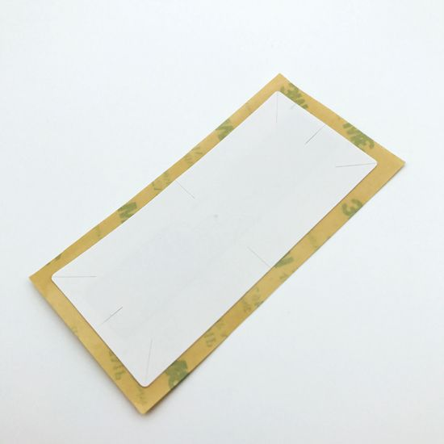
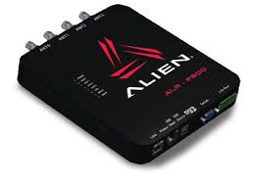
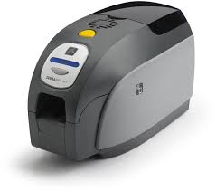
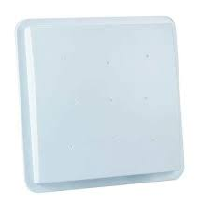
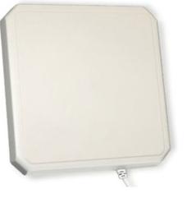
PRODUCTS

Slide 7
Thanks You
THANK Y
For your wathcing
PRESENTER NAME: PRAMOD C
CUSTOMER NAME: COCHIN PORT TRUST

